Slide 1
Introduction to data ware housing
Data Mining: Concepts and Techniques

Slide 2
Data Warehousing and OLAP Technology: An Overview
What is a data warehouse?
A multi-dimensional data model
Data warehouse architecture
Data warehouse implementation
From data warehousing to data mining
Data Mining: Concepts and Techniques

Slide 3
What is Data Warehouse?
Defined in many different ways, but not rigorously.
  A decision support database that is maintained separately from the organization’s operational database
  Support information processing by providing a solid platform of consolidated, historical data for analysis.
“A data warehouse is a subject-oriented, integrated, time-variant, and nonvolatile collection of data in support of management’s decision-making process.”—W. H. Inmon
Data warehousing:
  The process of constructing and using data warehouses
Data Mining: Concepts and Techniques

Slide 4
Data Warehouse—Subject-Oriented
Organized around major subjects, such as customer, product, sales
Focusing on the modeling and analysis of data for decision makers, not on daily operations or transaction processing
Provide a simple and concise view around particular subject issues by excluding data that are not useful in the decision support process
Data Mining: Concepts and Techniques

Slide 5
Data Warehouse—Integrated
Constructed by integrating multiple, heterogeneous data sources
  relational databases, flat files, on-line transaction records
Data cleaning and data integration techniques are applied.
  Ensure consistency in naming conventions, encoding structures, attribute measures, etc. among different data sources
    E.g., Hotel price: currency, tax, breakfast covered, etc.
  When data is moved to the warehouse, it is converted.
Data Mining: Concepts and Techniques

Slide 6
Data Warehouse—Time Variant
The time horizon for the data warehouse is significantly longer than that of operational systems
  Operational database: current value data
  Data warehouse data: provide information from a historical perspective (e.g., past 5-10 years)
Every key structure in the data warehouse
  Contains an element of time, explicitly or implicitly
  But the key of operational data may or may not contain “time element”
Data Mining: Concepts and Techniques

Slide 7
Data Warehouse—Nonvolatile
A physically separate store of data transformed from the operational environment
Operational update of data does not occur in the data warehouse environment
  Does not require transaction processing, recovery, and concurrency control mechanisms
  Requires only two operations in data accessing:
    initial loading of data and access of data
Data Mining: Concepts and Techniques

Slide 8
Data Warehouse vs. Heterogeneous DBMS
Traditional heterogeneous DB integration: A query driven approach
  Build wrappers/mediators on top of heterogeneous databases
  When a query is posed to a client site, a meta-dictionary is used to translate the query into queries appropriate for individual heterogeneous sites involved, and the results are integrated into a global answer set
  Complex information filtering, compete for resources
Data warehouse: update-driven, high performance
  Information from heterogeneous sources is integrated in advance and stored in warehouses for direct query and analysis
Data Mining: Concepts and Techniques

Slide 9
Operational Database
An operational database is the database that is accessed and updated on a continual basis and usually handles the daily transactions for a business. Operational databases use an OLTP approach and are designed to be write-optimized.
OLTP
On-Line Transaction Processing (OLTP) is the process in which systems facilitate and manage data entry and retrieval on a frequent basis. The transaction is almost immediately processed and is the main strategy of operational databases. An example of an OLTP system would be an ATM machine. The benefits of using OLTP is that it is fast and efficient and simplifies the process of accessing data. (Business Intelligence).
Data Mining: Concepts and Techniques

Slide 10
Data Warehouse vs. Operational DBMS
OLTP (on-line transaction processing)
  Major task of traditional relational DBMS
  Day-to-day operations: purchasing, inventory, banking, manufacturing, payroll, registration, accounting, etc.
OLAP (on-line analytical processing)
  Major task of data warehouse system
  Data analysis and decision making
Distinct features (OLTP vs. OLAP):
  User and system orientation: customer vs. market
  Data contents: current, detailed vs. historical, consolidated
  Database design: ER + application vs. star + subject
  View: current, local vs. evolutionary, integrated
  Access patterns: update vs. read-only but complex queries
Data Mining: Concepts and Techniques

Slide 11
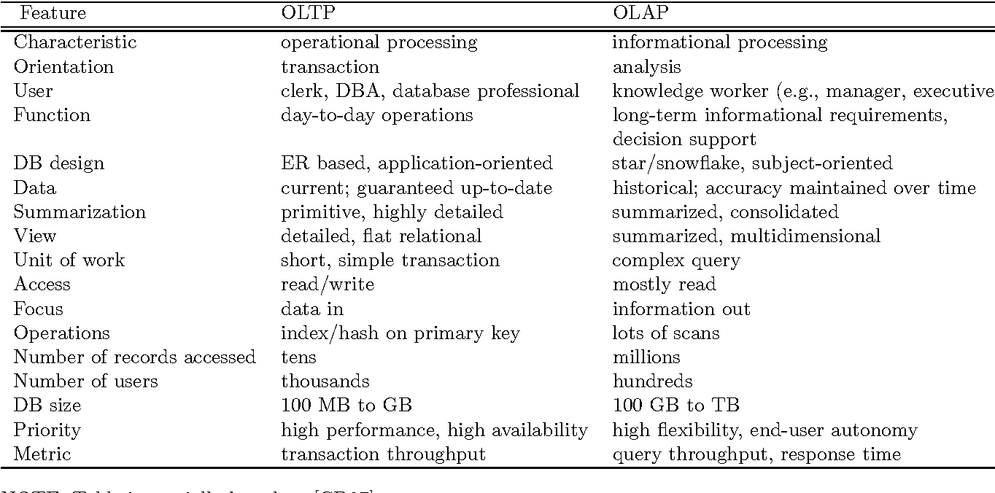
OLTP vs. OLAP
Data Mining: Concepts and Techniques

Slide 12
Why Separate Data Warehouse?
High performance for both systems
  DBMS— tuned for OLTP: access methods, indexing, concurrency control, recovery
  Warehouse—tuned for OLAP: complex OLAP queries, multidimensional view, consolidation
Different functions and different data:
  missing data: Decision support requires historical data which operational DBs do not typically maintain
  data consolidation: DS requires consolidation (aggregation, summarization) of data from heterogeneous sources
  data quality: different sources typically use inconsistent data representations, codes and formats which have to be reconciled
Note: There are more and more systems which perform OLAP analysis directly on relational databases
Data Mining: Concepts and Techniques

Slide 13
Data Warehousing and OLAP Technology: An Overview
What is a data warehouse?
A multi-dimensional data model
Data warehouse architecture
Data warehouse implementation
From data warehousing to data mining
Data Mining: Concepts and Techniques

Slide 14
From Tables and Spreadsheets to Data Cubes
A data warehouse is based on a multidimensional data model which views data in the form of a data cube
A data cube allows data to be modeled and viewed in multiple dimensions.
It is defined by dimensions and facts.
  Dimension tables are perspectives or entities w.r.t. which an org. wants to keep records.
  For example, All Electronics may create a sales data warehouse in order to keep records of the store’s sales with sales with respect to the dimensions time, item, branch, and location.
Data Mining: Concepts and Techniques

Slide 15
Dimension table
  These dimensions allow the store to keep track of things like monthly sales of items and the branches and locations at which the items were sold.
  Each dimension may have a table associated with it, called a dimension table.
  For example, a dimension table for item (item_name, brand, type), or time(day, week, month, quarter, year), branch, and location.
  Dimension tables can be specified by users or experts, or automatically generated and adjusted based on data distributions.
Data Mining: Concepts and Techniques

Slide 16
Fact table
  A multidimensional data model is typically organized around a central theme, like sales, for instance.
  This theme is represented by a Fact table.
  Facts are numerical measures.
  Think of them as the quantities by which we want to analyze relationships between dimensions.
  Examples of facts for a sales data warehouse include dollars sold (sales amount in dollars), units sold (number of units sold), and amount budgeted.
  Fact table contains measures (such as dollars_sold) and keys to each of the related dimension tables
Data Mining: Concepts and Techniques

Slide 17
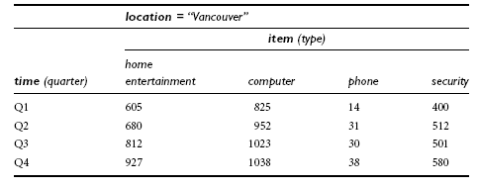
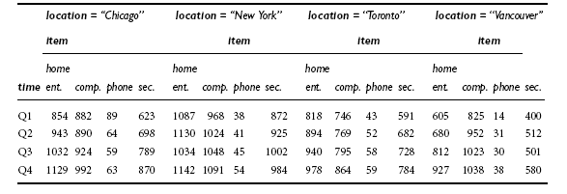
we will look at the AllElectronics sales data for items sold per quarter in the city of Vancouver.
Data Mining: Concepts and Techniques

Slide 18
Data cube
A data cube, such as sales, allows data to be modeled and viewed in multiple dimensions
Suppose ALLELETRONICS create a sales data warehouse with respect to dimensions
  Time
  Item
  Location
Data Mining: Concepts and Techniques

Slide 19
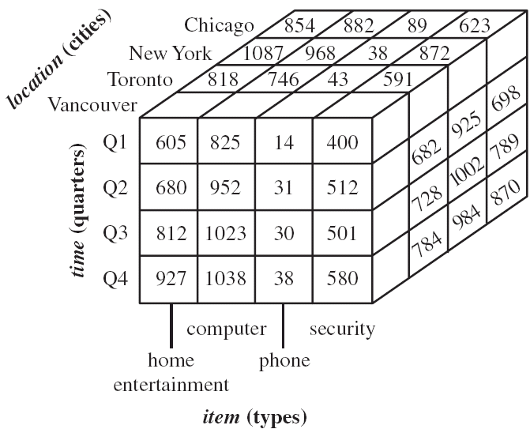
3D Data cube Example
Data Mining: Concepts and Techniques

Slide 20
Data cube
A data cube, such as sales, allows data to be modeled and viewed in multiple dimensions
Suppose ALLELETRONICS create a sales data warehouse with respect to dimensions
  Time
  Item
  Location
  Supplier
  Note: we may display any data n-D data as a series of (n-1)D “cubes”.
Data Mining: Concepts and Techniques

Slide 21
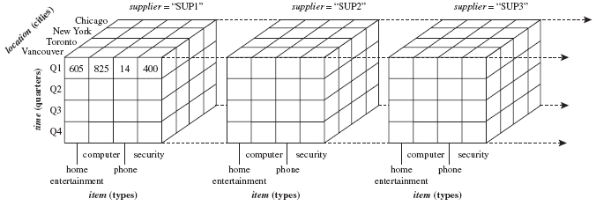
4D Data cube Example
Data Mining: Concepts and Techniques

Slide 22
In data warehousing literature, an n-D base cube or the cuboid that holds the lowest level of summarization is called a base cuboid. The top most 0-D cuboid , which holds the highest-level of summarization, is called the apex cuboid.
The lattice of cuboids forms a data cube.
Figure shows a lattice of cuboids forming a data cube for the dimensions time, item, location, and supplier.
Data Mining: Concepts and Techniques

Slide 23
Cube: A Lattice of Cuboids
all
0-D(apex) cuboid
time
item
location
supplier
1-D cuboids
time,location
item,location
location,supplier
time,item
2-D cuboids
time,supplier
item,supplier
time,location,supplier
3-D cuboids
time,item,location
time,item,supplier
item,location,supplier
4-D(base) cuboid
time, item, location, supplier
Data Mining: Concepts and Techniques

Slide 24
Conceptual Modeling of Data Warehouses
Modeling data warehouses: dimensions & measures
  Star schema:
  A large central table (fact table) containing the bulk of the data, with no redundancy.
  A set of smaller attendant tables (dimension tables) one for each dimension.
  A fact table in the middle connected to a set of dimension tables
  The schema graph resembles a starburst, with the dimension tables displayed in a radial pattern around the central fact table.
Data Mining: Concepts and Techniques

Slide 25
Example of Star Schema
time
time_key
day
day_of_the_week
month
quarter
year
item
item_key
item_name
brand
type
supplier_type
Sales Fact Table
time_key
item_key
branch_key
branch
location
location_key
branch_key
branch_name
branch_type
location_key
street
city
state_or_province
country
units_sold
dollars_sold
avg_sales
Measures
Data Mining: Concepts and Techniques

Slide 26
Example for redundancy
In the star schema, each dimension is represented by only one table, and each table contains a set of attributes. For example, the location dimension table contains the attribute set {location key, street, city, province or state, country}.
This constraint may introduce some redundancy.
For example, “Vancouver” and “Victoria” are both cities in the Canadian province of British Columbia.
Entries for such cities in the location dimension table will create redundancy among the attributes province or state and country, that is, (..., Vancouver, British Columbia, Canada) and (..., Victoria, British Columbia, Canada).
Data Mining: Concepts and Techniques

Slide 27
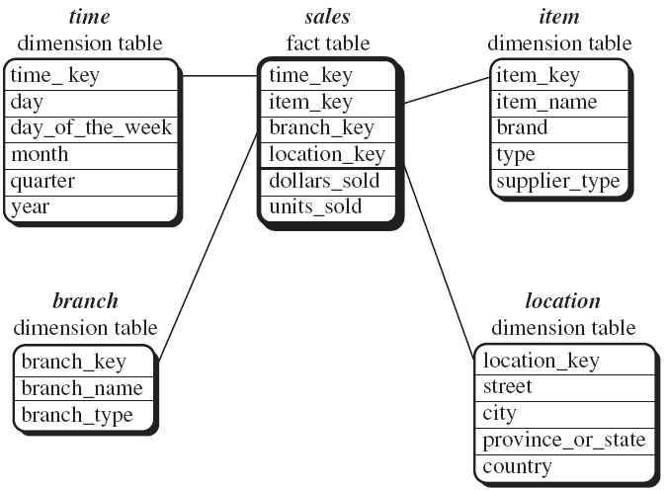
Star schema
Data Mining: Concepts and Techniques

Slide 28
Conceptual Modeling of Data Warehouses
  Snowflake schema: A refinement of star schema where some dimensional hierarchy is normalized into a set of smaller dimension tables, forming a shape similar to snowflake
Data Mining: Concepts and Techniques

Slide 29
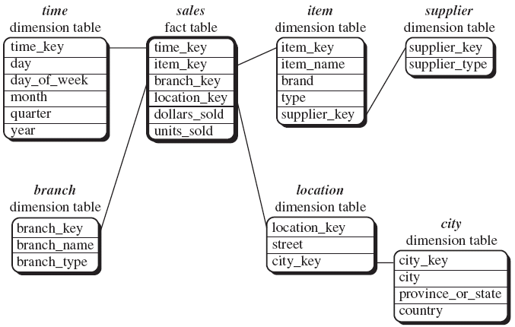
Snowflake schema
Data Mining: Concepts and Techniques

Slide 30
Differences between star and snowflakes schema
Snowflake model is normalized to reduce redundancies.
Table is easy to maintain and saves storage space.
The snowflake structure can reduce the effectiveness of browsing, since more joins will be needed to execute a query.
Although the snowflake schema reduces redundancy, it is not as the star schema in data warehouse design.
Data Mining: Concepts and Techniques

Slide 31
Example of Snowflake Schema
time
item
time_key
day
day_of_the_week
month
quarter
year
item_key
item_name
brand
type
supplier_key
supplier
Sales Fact Table
supplier_key
supplier_type
time_key
item_key
branch_key
branch
location
location_key
location_key
street
city_key
branch_key
branch_name
branch_type
units_sold
dollars_sold
city
city_key
city
state_or_province
country
avg_sales
Measures
Data Mining: Concepts and Techniques

Slide 32
Conceptual Modeling of Data Warehouses
  Fact constellations: Multiple fact tables share dimension tables, viewed as a collection of stars, therefore called galaxy schema or fact constellation
Data Mining: Concepts and Techniques

Slide 33
Example of Fact Constellation
time
time_key
day
day_of_the_week
month
quarter
year
item
Shipping Fact Table
item_key
item_name
brand
type
supplier_type
Sales Fact Table
time_key
time_key
item_key
shipper_key
item_key
branch_key
from_location
branch
location_key
location
to_location
branch_key
branch_name
branch_type
units_sold
location_key
street
city
province_or_state
country
dollars_cost
dollars_sold
units_shipped
avg_sales
shipper
Measures
shipper_key
shipper_name
location_key
shipper_type
Data Mining: Concepts and Techniques

Slide 34
In data warehousing, there is a distinction between a data warehouse and a data mart.
A data warehouse collects information about subjects that span the entire organization, such as customers, items, sales, assets, and personnel, and thus its scope is enterprise-wide.
For data warehouses, the fact constellation schema is commonly used, since it can model multiple, interrelated subjects. A data mart, on the other hand, is a department subset of the data warehouse that focuses on selected subjects, and thus its scope is department-wide.
For data marts, the star or snowflake schema are commonly used, since both are geared toward modeling single subjects, although the star schema is more popular and efficient.
Data Mining: Concepts and Techniques

Slide 35
Cube Definition Syntax (BNF) in DMQL
Multidimensional Schema definition of the data:
Data warehouses and data marts can be defined using two language primitives:
Cube Definition (Fact Table)
  define cube <cube_name> [<dimension_list>]: <measure_list>
Dimension Definition (Dimension Table)
  define dimension <dimension_name> as (<attribute_or_subdimension_list>)
Data Mining: Concepts and Techniques

Slide 36
Defining Star Schema in DMQL
define cube sales_star [time, item, branch, location]:
    dollars_sold = sum(sales_in_dollars),
    avg_sales = avg(sales_in_dollars),
    units_sold = count(*)
define dimension time as (time_key, day, day_of_week, month, quarter, year)
define dimension item as (item_key, item_name, brand, type, supplier_type)
define dimension branch as (branch_key, branch_name, branch_type)
define dimension location as (location_key, street, city, province_or_state, country)
Data Mining: Concepts and Techniques

Slide 37
Defining Snowflake Schema in DMQL
This definition is similar to that of sales _star , except that, here, the item and location dimension tables are normalized.
define cube sales_snowflake [time, item, branch, location]:
    dollars_sold = sum(sales_in_dollars),
    avg_sales = avg(sales_in_dollars), units_sold = count(*)
define dimension time as (time_key, day, day_of_week, month, quarter, year)
define dimension item as (item_key, item_name, brand, type, supplier(supplier_key, supplier_type))
define dimension branch as (branch_key, branch_name, branch_type)
define dimension location as (location_key, street, city(city_key, province_or_state, country))
Data Mining: Concepts and Techniques

Slide 38
Defining Fact Constellation in DMQL
define cube sales [time, item, branch, location]:
dollars_sold = sum(sales_in_dollars),
avg_sales = avg(sales_in_dollars), units_sold = count(*)
define dimension time as (time_key, day, day_of_week, month, quarter, year)
define dimension item as (item_key, item_name, brand, type, supplier_type)
define dimension branch as (branch_key, branch_name, branch_type)
define dimension location as (location_key, street, city, province_or_state, country)
define cube shipping [time, item, shipper, from_location, to_location]:
    dollar_cost = sum(cost_in_dollars), unit_shipped = count(*)
define dimension time as time in cube sales
define dimension item as item in cube sales
define dimension shipper as (shipper_key, shipper_name, location as location in cube sales, shipper_type)
define dimension from_location as location in cube sales
define dimension to_location as location in cube sales
Data Mining: Concepts and Techniques

Slide 39
Measures of Data Cube: Three Categories
Distributive: if the result derived by applying the function to n aggregate values is the same as that derived by applying the function on all the data without partitioning
    E.g., count(), sum(), min(), max()
Algebraic: if it can be computed by an algebraic function with M arguments (where M is a bounded integer), each of which is obtained by applying a distributive aggregate function
    E.g., avg(), min_N(), standard_deviation()
Holistic: if there is no constant bound on the storage size needed to describe a subaggregate.
    E.g., median(), mode(), rank()
Data Mining: Concepts and Techniques

Slide 40
Concept Hierarchies
A Concept Hierarchy defines a sequence of mappings from a set of low-level concepts to high-level
Consider a concept hierarchy for the dimension “Location”
Data Mining: Concepts and Techniques

Slide 41
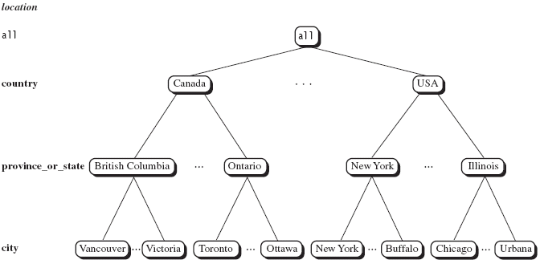
Concept Hierarchies
Data Mining: Concepts and Techniques

Slide 42
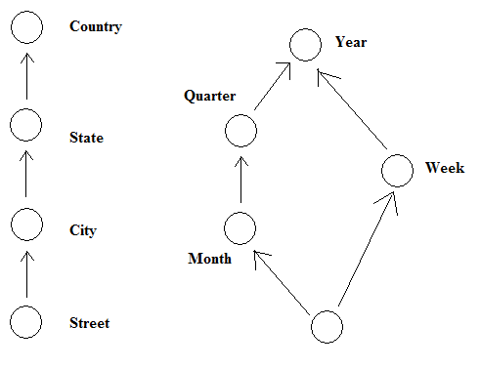
Concept Hierarchies
Many concept hierarchies are implicit within the database system
Data Mining: Concepts and Techniques

Slide 43
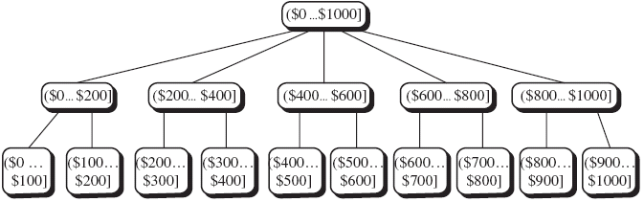
Concept Hierarchies
Concept hierarchies may also be defined by grouping values for a given dimension or attribute, resulting in a set-grouping hierarchy
Data Mining: Concepts and Techniques

Slide 44
A Concept Hierarchy: Dimension (location)
all
all
region
Europe
...
North_America
country
Germany
...
Spain
Canada
...
Mexico
city
Frankfurt
...
Vancouver
...
Toronto
office
L. Chan
...
M. Wind
Data Mining: Concepts and Techniques

Slide 45
Multidimensional Data
Sales volume as a function of product, month, and region
Dimensions: Product, Location, Time
Hierarchical summarization paths
Region
Industry Region Year
Category Country Quarter
Product City Month Week
Office Day
Product
Month
Data Mining: Concepts and Techniques

Slide 46

A Sample Data Cube
Date
Total annual sales
of TV in U.S.A.
1Qtr
2Qtr
3Qtr
4Qtr
sum
Product
TV
PC
U.S.A
VCR
sum
Canada
Country
Mexico
sum
All, All, All
Data Mining: Concepts and Techniques

Slide 47
Cuboids Corresponding to the Cube
all
0-D(apex) cuboid
product
date
country
1-D cuboids
product,date
product,country
date, country
2-D cuboids
3-D(base) cuboid
product, date, country
Data Mining: Concepts and Techniques

Slide 48

Browsing a Data Cube
Visualization
OLAP capabilities
Interactive manipulation
Data Mining: Concepts and Techniques

Slide 49
OLAP Operation
So, how are concept hierarchies useful in OLAP?
In the multidimensional model, data are organized into multiple dimensions.
And each dimension contains multiple levels of abstraction defined by concept hierarchies.
This organization provides users with the flexibility to view data from different perspectives.
A number of OLAP data cube operations exist to materialize these different views, allowing interactive querying and analysis of the data at hand. Hence, OLAP provides a user-friendly environment for interactive data analysis.
Data Mining: Concepts and Techniques

Slide 50
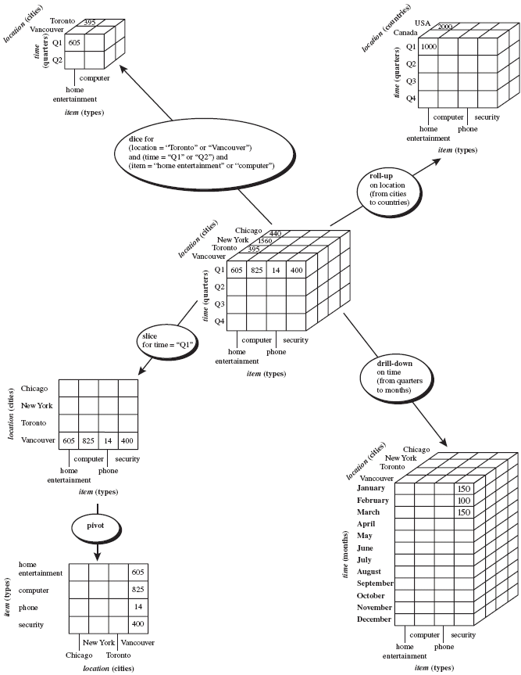
Data Mining: Concepts and Techniques

Slide 51
Typical OLAP Operations
Roll up (drill-up): summarize data
  by climbing up hierarchy or by dimension reduction
Drill down (roll down): reverse of roll-up
  from higher level summary to lower level summary or detailed data, or introducing new dimensions
Data Mining: Concepts and Techniques

Slide 52
Typical OLAP Operations
Slice and dice: project and select
Pivot (rotate):
  reorient the cube, visualization, 3D to series of 2D planes
Data Mining: Concepts and Techniques

Slide 53
Typical OLAP Operations
Roll up (drill-up): summarize data
  by climbing up hierarchy or by dimension reduction
Drill down (roll down): reverse of roll-up
  from higher level summary to lower level summary or detailed data, or introducing new dimensions
Slice and dice: project and select
Pivot (rotate):
  reorient the cube, visualization, 3D to series of 2D planes
Other operations
  drill across: involving (across) more than one fact table
  drill through: through the bottom level of the cube to its back-end relational tables (using SQL)
Data Mining: Concepts and Techniques

Slide 54
A Star-Net Query Model
Customer Orders
Shipping Method
Customer
CONTRACTS
AIR-EXPRESS
ORDER
TRUCK
PRODUCT LINE
Time
Product
ANNUALY
QTRLY
DAILY
PRODUCT ITEM
PRODUCT GROUP
CITY
SALES PERSON
COUNTRY
DISTRICT
REGION
DIVISION
Location
Each circle is called a footprint
Promotion
Organization
Data Mining: Concepts and Techniques

Slide 55
Chapter 3: Data Warehousing and OLAP Technology: An Overview
What is a data warehouse?
A multi-dimensional data model
Data warehouse architecture
Data warehouse implementation
From data warehousing to data mining
Data Mining: Concepts and Techniques

Slide 56
Data warehouse architecture
Steps for the Design and Construction of DataWarehouses
we presents a business analysis framework for data warehouse design.
The Design of a DataWarehouse: A Business Analysis Framework
“What can business analysts gain from having a data warehouse?”
First, having a datawarehouse may provide a competitive advantage by presenting relevant information from which to measure performance and make critical adjustments in order to help win over competitors.
Second, a data warehouse can enhance business productivity because it is able to quickly and efficiently gather information that accurately describes the organization.
Third, a data warehouse facilitates customer relationship management because it provides a consistent view of customers and items across all lines of business, all departments, and all markets.
Finally, a data warehouse may bring about cost reduction by tracking trends, patterns, and exceptions over long periods in a consistent and reliable manner.
Data Mining: Concepts and Techniques

Slide 57
To design an effective data warehouse we need to understand and analyze business needs and construct a business analysis framework.
The construction of a large and complex information system can be viewed as the construction of a large and complex building, for which the owner, architect, and builder have different views.
These views are combined to form a complex framework that represents the top-down, business-driven, or owner’s perspective, as well as the bottom-up, builder-driven, or implementor’s view of the information system.
Data Mining: Concepts and Techniques

Slide 58
Design of Data Warehouse: A Business Analysis Framework
Four views regarding the design of a data warehouse
  Top-down view
    allows selection of the relevant information necessary for the data warehouse. This information matches the current and future business needs.
  Data source view
    exposes the information being captured, stored, and managed by operational systems
  Data warehouse view
    consists of fact tables and dimension tables
  Business query view
    sees the perspectives of data in the warehouse from the view of end-user
Data Mining: Concepts and Techniques

Slide 59
Building and using a data warehouse is a complex task because it requires business skills, technology skills, and program management skills.
Business skills
  how to build extractors that transfer data from the operational system to the data warehouse, and
  how to build warehouse refresh software that keeps the data warehouse reasonably up-to-date with the operational system’s data.
  understanding and translating the business requirements into queries that can be satisfied by the data warehouse.
Technology skills
  data analysts are required to understand how to make assessments from quantitative information and derive facts based on conclusions from historical information in the data warehouse.
Program management skills
  involve the need to interface with many technologies, vendors, and end users in order to deliver results in a timely and cost-effective manners.
Data Mining: Concepts and Techniques

Slide 60
Data Warehouse Design Process
Top-down, bottom-up approaches or a combination of both
  Top-down: Starts with overall design and planning (mature)
  Bottom-up: Starts with experiments and prototypes (rapid)
From software engineering point of view
  the design and construction of a data warehouse may consist of the following steps:
  planning, requirements study, problem analysis, warehouse design, data integration and testing, and finally deployment of the datawarehouse.
Large software systems can be developed using two methodologies:
  Waterfall: structured and systematic analysis at each step before proceeding to the next
  Spiral: rapid generation of increasingly functional systems, with short intervals between successive releases. Short turn around time, modifications can be done quickly, and new designs and technologies can be adapted in a timely manner.
Data Mining: Concepts and Techniques

Slide 61
Typical data warehouse design process
  Choose a business process to model
    e.g., orders, invoices, shipments, inventory, account administration, sales, or the general ledger.
  Choose the grain (atomic level of data) of the business process.
    The grain is the fundamental, atomic level of data to be represented in the fact table for this process, for example, individual transactions, individual daily snapshots, and so on.
  Choose the dimensions that will apply to each fact table record
  Choose the measure that will populate each fact table record
Data Mining: Concepts and Techniques

Slide 62
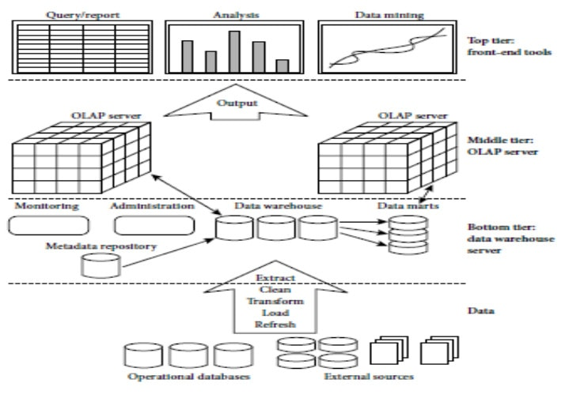
A three-tier data warehousing architecture
Data Mining: Concepts and Techniques

Slide 63
Three Data Warehouse Models
Enterprise warehouse
  collects all of the information about subjects spanning the entire organization
Data Mart
  a subset of corporate-wide data that is of value to a specific groups of users. Its scope is confined to specific, selected groups, such as marketing data mart
    Independent vs. dependent (directly from warehouse) data mart
Virtual warehouse
  A set of views over operational databases
  Only some of the possible summary views may be materialized
Data Mining: Concepts and Techniques

Slide 64
Data Warehouse Development: A Recommended Approach
Multi-Tier Data Warehouse
Distributed Data Marts
Enterprise Data Warehouse
Data Mart
Data Mart
Model refinement
Model refinement
Define a high-level corporate data model
Data Mining: Concepts and Techniques

Slide 65
Data Warehouse Back-End Tools and Utilities
Data extraction
  get data from multiple, heterogeneous, and external sources
Data cleaning
  detect errors in the data and rectify them when possible
Data transformation
  convert data from legacy or host format to warehouse format
Load
  sort, summarize, consolidate, compute views, check integrity, and build indicies and partitions
Refresh
  propagate the updates from the data sources to the warehouse
Data Mining: Concepts and Techniques

Slide 66
Metadata Repository
Meta data is the data defining warehouse objects. It stores:
Description of the structure of the data warehouse
  schema, view, dimensions, hierarchies, derived data defn, data mart locations and contents
Operational meta-data
  data lineage (history of migrated data and transformation path), currency of data (active, archived, or purged), monitoring information (warehouse usage statistics, error reports, audit trails)
The algorithms used for summarization
The mapping from operational environment to the data warehouse
Data related to system performance
  warehouse schema, view and derived data definitions
Business data
  business terms and definitions, ownership of data, charging policies
Data Mining: Concepts and Techniques

Slide 67
OLAP Server Architectures
Relational OLAP (ROLAP)
  Use relational or extended-relational DBMS to store and manage warehouse data and OLAP middle ware
  Include optimization of DBMS backend, implementation of aggregation navigation logic, and additional tools and services
  Greater scalability
Multidimensional OLAP (MOLAP)
  Sparse array-based multidimensional storage engine
  Fast indexing to pre-computed summarized data
Hybrid OLAP (HOLAP) (e.g., Microsoft SQLServer)
  Flexibility, e.g., low level: relational, high-level: array
Specialized SQL servers (e.g., Redbricks)
  Specialized support for SQL queries over star/snowflake schemas
Data Mining: Concepts and Techniques

Slide 68
Chapter 3: Data Warehousing and OLAP Technology: An Overview
What is a data warehouse?
A multi-dimensional data model
Data warehouse architecture
Data warehouse implementation
From data warehousing to data mining
Data Mining: Concepts and Techniques

Slide 69
Data Warehouse Implementation
Data warehouses contain huge volumes of data.
OLAP servers demand that queries should be answered in seconds.
So, data warehouse should need highly efficient cube computation techniques, access methods and query processing techniques.
The core of multidimensional data analysis is the efficient computation of aggregations across many sets of dimensions.
In SQL aggregations are referred to as group-by’s.
Each group-by can be represented as cuboid.
Set of group-by’s forms a lattice of a cuboids defining a data cube.
Data Mining: Concepts and Techniques

Slide 70
Efficient Data Cube Computation
The compute cube Operator and the Curse of Dimensionality
The compute cube operator computes aggregates over all subsets of the dimensions specified in the operation.
Requires an excessive storage space, especially for large number of dimensions.
A data cube is a lattice of cuboids.
Suppose that we create a data cube for AllElectronics sales that contains the following: city, item, year, and sales_in_dollars.
        Compute the sum of sales, grouping by city and item.
        Compute the sum of sales, grouping by city.
        Compute the sum of sales, grouping by item.
Data Mining: Concepts and Techniques

Slide 71
Efficient Data Cube Computation
What is the total number of cuboids, or group-by’s, that can be computed for this data cube?
Three attributes: city, item, year (dimensions)
sales_in_dollars (measure)
The total number of cuboids or group-by’s computed for this cube are 2³=8.
Group-by’s: {(city,item,year), (city, item), (city, year), (item, year), (city), (item), (year),()}.
() : group-by is empty i.e. the dimensions are not grouped.
Base cuboid contains all three dimensions.
Apex cuboid is empty.
Data Mining: Concepts and Techniques

Slide 72
Cube Operation
Cube definition and computation in DMQL
define cube sales_cube[ city, item, year]:
(sales_in_dollars)
    compute cube sales_cube
Transform it into a SQL-like language (with a new operator cube by, introduced by Gray et al.’96)
    SELECT item, city, year, SUM (amount)
    FROM SALES
    CUBE BY item, city, year
()
(city)
(item)
(year)
(city, item)
(city, year)
(item, year)
(city, item, year)
Data Mining: Concepts and Techniques

Slide 73
Efficient Data Cube Computation
On-line analytical processing may need to access different cuboids for different queries.
So we have to compute all or at least some of the cuboids in the data cube in advance.
Precomputation leads to fast response time and avoids some redundant computation.
A major challenge related to precomputation would be storage space if all the cuboids in the data cube are computed, especially when the cube has many dimensions.
The storage requirements are even more excessive when many of the dimensions have associated concept hierarchies, each with multiple levels.
This problem is referred to as the Curse of Dimensionality.
Data Mining: Concepts and Techniques

Slide 74

Efficient Data Cube Computation
Data cube can be viewed as a lattice of cuboids
  The bottom-most cuboid is the base cuboid
  The top-most cuboid (apex) contains only one cell
  How many cuboids in an n-dimensional cube with L levels?
For example, the time dimension as specified above has 4 conceptual levels, or 5 if we include the virtual level all.
If the cube has 10 dimensions and each dimension has 5 levels (including all), the total number of cuboids that can be generated is 5¹⁰ 9.8x10⁶.
Data Mining: Concepts and Techniques

Slide 75
Partial Materialization: Selected Computation of Cuboids
There are three choices for data cube materialization given a base cuboid.
No Materialization
Full Materialization
Partial Materialization
      Identify the subsets of cuboids or subcubes to materialize.
      Exploit the materialized cuboids or subcubes during query processing.
      Efficiently update the materialized cuboids or subcubes during load and refresh.
Selection of which cuboids to materialize
    Based on size, queries in the workload, accessing cost, their frequencies, etc.
Data Mining: Concepts and Techniques

Slide 76

Iceberg Cube
Computing only the cuboid cells whose count or other aggregates satisfying the condition like
      HAVING COUNT(*) >= minsup
Motivation
  Only a small portion of cube cells may be “above the water’’ in a sparse cube
  Only calculate “interesting” cells—data above certain threshold
  Avoid explosive growth of the cube
Data Mining: Concepts and Techniques

Slide 77



Indexing OLAP Data: Bitmap Index
Index on a particular column
Each value in the column has a bit vector: bit-op is fast
The length of the bit vector: # of records in the base table
The i-th bit is set if the i-th row of the base table has the value for the indexed column
not suitable for high cardinality domains
Base table
Index on Region
Index on Type
Data Mining: Concepts and Techniques

Slide 78
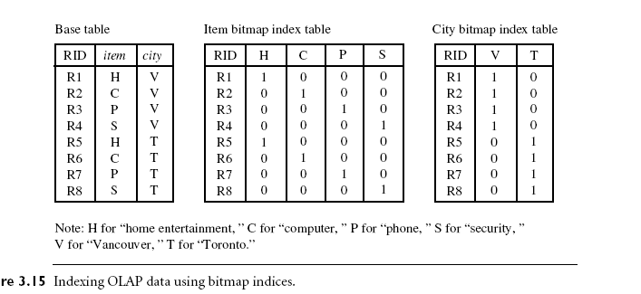
Indexing OLAP Data:
Data Mining: Concepts and Techniques

Slide 79
Indexing OLAP Data: Join Indices
The join indexing method gained popularity from its use in relational database query processing.
The join index records can identify joinable tuples without performing costly join operations.
Join indexing is especially useful for maintaining the relationship between a foreign key and its matching primary keys, from the joinable relation.
Data Mining: Concepts and Techniques

Slide 80

Example : we defined a star schema for AllElectronics of the form “sales star [time, item, branch, location]: dollars sold = sum (sales in dollars)”. An example of a join index relationship between the sales fact table and the dimension tables for location and item is shown in Figure For example, the “Main Street” value in the location dimension table joins with tuples T57, T238, and T884 of the sales fact table. Similarly, the “Sony-TV” value in the item dimension table joins with tuples T57 and T459 of the sales fact table. The corresponding join index tables are shown in Figure in next slide….
Data Mining: Concepts and Techniques

Slide 81
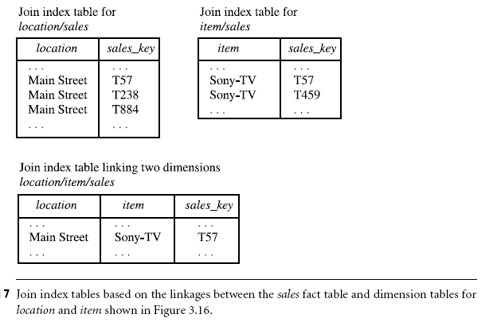
Data Mining: Concepts and Techniques

Slide 82
Suppose that there are 360 time values, 100 items, 50 branches, 30 locations, and 10 million sales tuples in the sales star data cube. If the sales fact table has recorded sales for only 30 items, the remaining 70 items will obviously not participate in joins. If join indices are not used, additional I/Os have to be performed to bring the joining portions of the fact table and dimension tables together.
To further speed up query processing, the join indexing and bitmap indexing methods can be integrated to form bitmapped join indices.
Microsoft SQL Server and Sybase IQ support bitmap indices. Oracle 8 uses bitmap and join indices.
Data Mining: Concepts and Techniques

Slide 83
Efficient Processing OLAP Queries
The purpose of materializing cuboids and constructing OLAP index structures is to speed up the query processing in data cubes.
Given materialized views, query processing should proceed as follows:
Determine which operations should be performed on the available cuboids
  Transform drill, roll, etc. into corresponding SQL and/or OLAP operations, e.g., dice = selection + projection
Determine to which materialized cuboid(s) the relevant operations should be applied.
Data Mining: Concepts and Techniques

Slide 84
Efficient Processing OLAP Queries
  Suppose that the query to be processed be on {brand, province_or_state} with the selection constant “year = 2004”, and there are 4 materialized cuboids available:
    1) {year, item_name, city}
    2) {year, brand, country}
    3) {year, brand, province_or_state}
    4) {item_name, province_or_state} where year = 2004
    Which of the cuboids should be selected to process the query?
Data Mining: Concepts and Techniques

Slide 85
Chapter 3: Data Warehousing and OLAP Technology: An Overview
What is a data warehouse?
A multi-dimensional data model
Data warehouse architecture
Data warehouse implementation
From data warehousing to data mining
Data Mining: Concepts and Techniques

Slide 86
Data Warehouse Usage
Three kinds of data warehouse applications
  Information processing
    supports querying, basic statistical analysis, and reporting using crosstabs, tables, charts and graphs
  Analytical processing
    Operates on historical data in both summarized and detailed forms.
    multidimensional data analysis of data warehouse data
    supports basic OLAP operations, slice-dice, drill-down, roll- up, and pivoting
  Data mining
    knowledge discovery from hidden patterns
    supports associations, constructing analytical models, performing classification and prediction, and presenting the mining results using visualization tools
Data Mining: Concepts and Techniques

Slide 87
Data Warehouse Usage
Do OLAP systems perform data mining? Are OLAP systems actually data mining systems?
OLAP is a data summarization/ aggregation tool that helps simplify data analysis.
Data mining allows the automated discovery of implicit patterns and interesting knowledge hidden in large amounts of data.
Data mining covers much broader spectrum than simple OLAP operations because it performs not only data summary and comparison but also association, classification, prediction, clustering, time-series analysis, and other data analysis tasks.
Data Mining: Concepts and Techniques

Slide 88
From On-Line Analytical Processing (OLAP) to On Line Analytical Mining (OLAM)
Why online analytical mining?
  High quality of data in data warehouses
    DW contains integrated, consistent, cleaned data
  Available information processing structure surrounding data warehouses
    ODBC, OLEDB, Web accessing, service facilities, reporting and OLAP tools
  OLAP-based exploratory data analysis
    Mining with drilling, dicing, pivoting, etc.
  On-line selection of data mining functions
    Integration and swapping of multiple mining functions, algorithms, and tasks
Data Mining: Concepts and Techniques

Slide 89
An Integrated OLAM and OLAP Architecture
Mining query
Mining result
Layer4
User Interface
User GUI API
OLAM
Engine
OLAP
Engine
Layer3
OLAP/OLAM
Data Cube API
Layer2
MDDB
MDDB
Meta Data
Filtering&Integration
Database API
Filtering
Layer1
Data Repository
Data cleaning
Data
Warehouse
Databases
Data integration
Data Mining: Concepts and Techniques

Slide 90
Chapter 3: Data Warehousing and OLAP Technology: An Overview
What is a data warehouse?
A multi-dimensional data model
Data warehouse architecture
Data warehouse implementation
From data warehousing to data mining
Summary
Data Mining: Concepts and Techniques

Slide 91
Summary: Data Warehouse and OLAP Technology
Why data warehousing?
A multi-dimensional model of a data warehouse
  Star schema, snowflake schema, fact constellations
  A data cube consists of dimensions & measures
OLAP operations: drilling, rolling, slicing, dicing and pivoting
Data warehouse architecture
OLAP servers: ROLAP, MOLAP, HOLAP
Efficient computation of data cubes
  Partial vs. full vs. no materialization
  Indexing OALP data: Bitmap index and join index
  OLAP query processing
From OLAP to OLAM (on-line analytical mining)
Data Mining: Concepts and Techniques

Slide 92
References (I)
S. Agarwal, R. Agrawal, P. M. Deshpande, A. Gupta, J. F. Naughton, R. Ramakrishnan, and S. Sarawagi. On the computation of multidimensional aggregates. VLDB’96
D. Agrawal, A. E. Abbadi, A. Singh, and T. Yurek. Efficient view maintenance in data warehouses. SIGMOD’97
R. Agrawal, A. Gupta, and S. Sarawagi. Modeling multidimensional databases. ICDE’97
S. Chaudhuri and U. Dayal. An overview of data warehousing and OLAP technology. ACM SIGMOD Record, 26:65-74, 1997
E. F. Codd, S. B. Codd, and C. T. Salley. Beyond decision support. Computer World, 27, July 1993.
J. Gray, et al. Data cube: A relational aggregation operator generalizing group-by, cross-tab and sub-totals. Data Mining and Knowledge Discovery, 1:29-54, 1997.
A. Gupta and I. S. Mumick. Materialized Views: Techniques, Implementations, and Applications. MIT Press, 1999.
J. Han. Towards on-line analytical mining in large databases. ACM SIGMOD Record, 27:97-107, 1998.
V. Harinarayan, A. Rajaraman, and J. D. Ullman. Implementing data cubes efficiently. SIGMOD’96
Data Mining: Concepts and Techniques

Slide 93
References (II)
C. Imhoff, N. Galemmo, and J. G. Geiger. Mastering Data Warehouse Design: Relational and Dimensional Techniques. John Wiley, 2003
W. H. Inmon. Building the Data Warehouse. John Wiley, 1996
R. Kimball and M. Ross. The Data Warehouse Toolkit: The Complete Guide to Dimensional Modeling. 2ed. John Wiley, 2002
P. O'Neil and D. Quass. Improved query performance with variant indexes. SIGMOD'97
Microsoft. OLEDB for OLAP programmer's reference version 1.0. In http://www.microsoft.com/data/oledb/olap, 1998
A. Shoshani. OLAP and statistical databases: Similarities and differences. PODS’00.
S. Sarawagi and M. Stonebraker. Efficient organization of large multidimensional arrays. ICDE'94
OLAP council. MDAPI specification version 2.0. In http://www.olapcouncil.org/research/apily.htm, 1998
E. Thomsen. OLAP Solutions: Building Multidimensional Information Systems. John Wiley, 1997
P. Valduriez. Join indices. ACM Trans. Database Systems, 12:218-246, 1987.
J. Widom. Research problems in data warehousing. CIKM’95.
Data Mining: Concepts and Techniques

Slide 94

Data Mining: Concepts and Techniques

